Slide 1
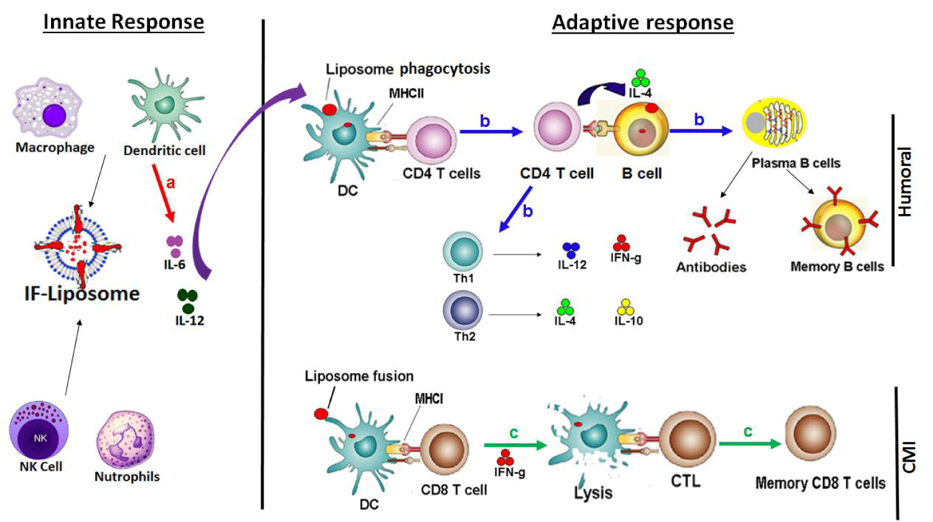
Figure 1: Simultaneous induction of innate and adaptive immune response by Immunostimulatory and fusogenic liposomes (IFLs). IFL may attract innate cells like DCs, macrophages leading to their immunostimulation and release of proinflammatory cytokines (pathway a). IFL may get phagocytosed by APCs and present antigen by MHCII molecule to CD4 T cells which may then activate and proliferate to different subtypes (Th1/Th2). CD4 T cells may also activate B cells through IL4 to produce antibodies (pathway b). IFL may get fused with APC and deliver antigen to the cytosol for presentation through MHCI to CD8 T cells which may lead to the generation of cytotoxic T cells to induce cell-mediated Immunity (pathway c).
Abbreviations: CL-Conventional Liposomes; IFL-Immunostimulatory-Fusogenic Liposomes; OVA- Ovalbumin; APC-Antigen presenting cell; CTL- Cytotoxic T cell; PAMP-Pathogen Associated Molecular Patterns; TPL-Total polar lipids; Cell mediated Immunity- CMI.

