Slide 1
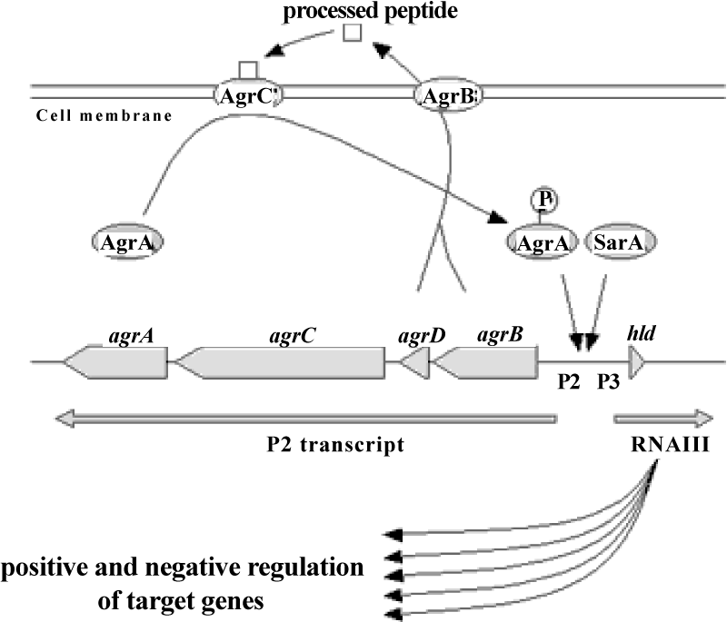
Figure 5: QS activity of S. aurous.

