Slide 1
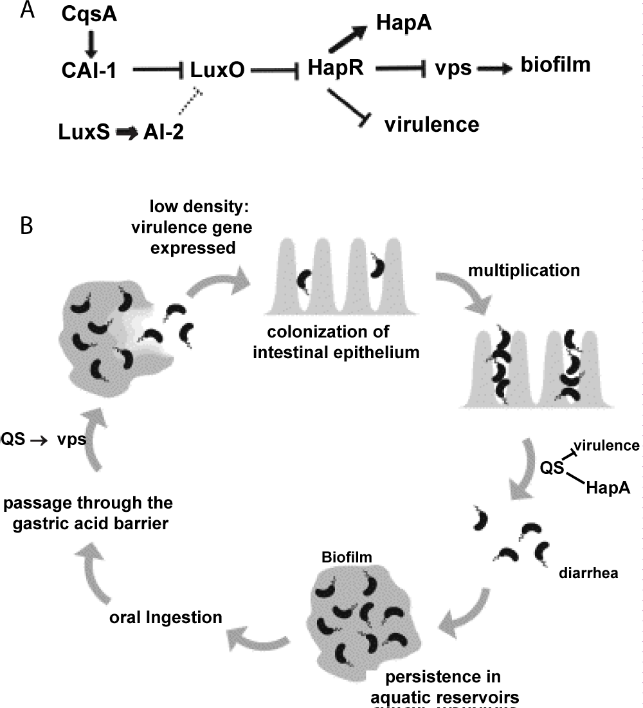
Figure 3: The role of QS in the Vibrio cholera in the intestine.

