Slide 1
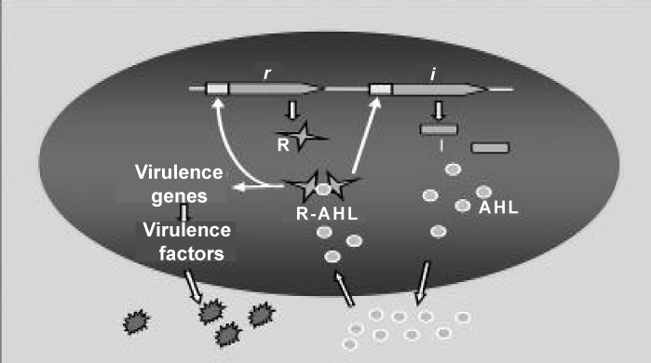
Figure 2: Molecules involved in signaling by QS.

