Slide 1
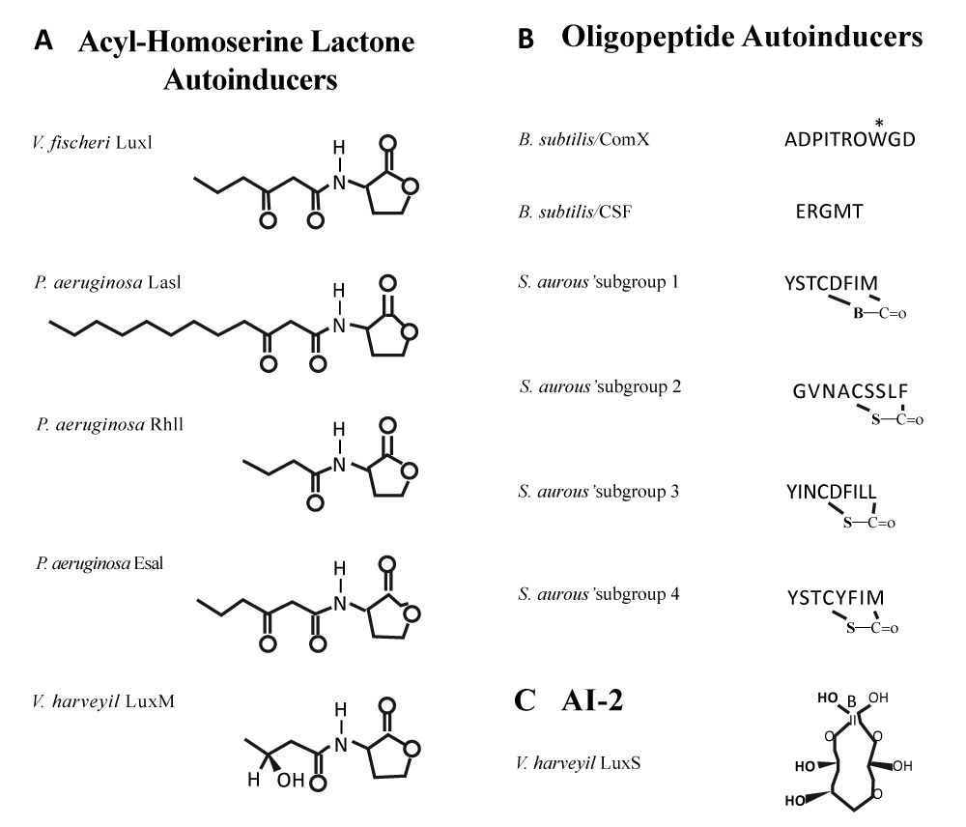
Figure 1: Different types of buildings are auto inductor (AI) in positive and Gram-negative bacteria.

